Slide 1
USED CARS PRICE ANALYSIS
Presented by
Madugula Varshitha

Slide 2
ABSTRACT
The objective of this project is to develop a web scraping tool that systematically extracts and analyses pricing data from the cars24 website, Enabling users to gain insights into the used car market
By automating the collection of information such as car models, prices, specifications, and mileage, the project aims to facilitate comprehensive market analysis and comparison
This data driven approach will empower potential buyers, sellers and automotive analysts to make informed decisions based on real-time market trends, ultimately enhancing their understanding of vehicle valuation and pricing dynamics in the used car sector

Slide 3
INTRODUCTION
The automotive market, particularly the used car segment, is characterized by rapid fluctuations in pricing and a diverse range of options available to consumers.
By leveraging web scraping techniques, we aim to gather essential information such as car models, prices, specifications, and mileage, which can be analyzed to identify market trends and pricing patterns.
The project will utilize Python and libraries like BeautifulSoup and Pandas to automate the data collection process, ensuring efficiency and accuracy.
Ultimately, the project seeks to enhance transparency in the used car market, empowering stakeholders to align their decisions with current market conditions and expectations.

Slide 4
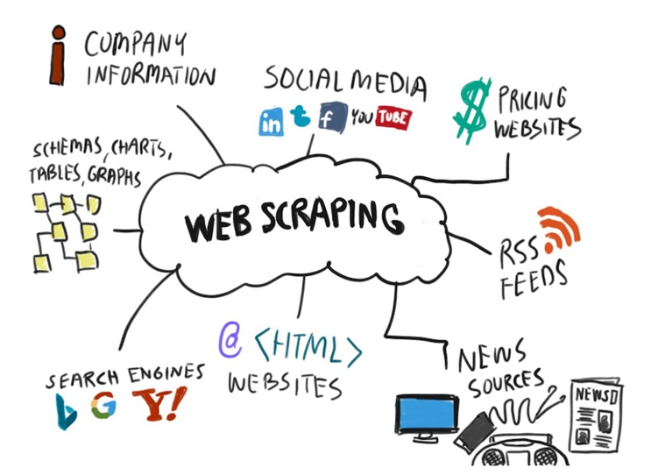
WEB SCRAPING
Web scraping is the process of automatically extracting data from websites. It involves fetching the content of a web page and parsing it to retrieve specific information, which can be stored and analyzed.
How It Works:
Fetching: A web scraper sends a request to a web server to retrieve the HTML content of a web page.
Parsing: The retrieved HTML is then parsed to locate and extract the desired data elements, such as text, images, or links.
Storing: The extracted data is typically stored in a structured format, such as a CSV file, database, or spreadsheet, for further analysis.

Slide 5
SOFTWARE AND PROGRAMMING
Software Requirement
1) Python ( Jupyter notebook)
2) Power Bi
3) Excel
Main Software Libraries
1) Pandas
2) Numpy
3) Beautiful Soups
4) Requests
5) CSV

Slide 6
A BRIEF CODE OVERVIEW
STEP 1 : IMPORT LIBRARIES
Import csv # csv file handling
Import requests # HTTP requests to interact with web
Import pandas as pd # Data manipulation using pandas
From bs4 import Beautiful Soup #HTML parsing using Beautifulsoup used to pull data out from HTML and XML files and we can search and modify phrase tree

Slide 7
STEP 2 : URL
Website = ‘https://www.cars24.com/buy-used-cars-chennai’
STEP 3 : CHECKING THE ACCESS OF URL
Headers = {
“User-Agent” : “Mozilla/5.0(Windows NT 10.0; Win64; x64) AppleWebkit/537.36
(KHTML, like Gecko) Chrome/96.0.4664.110 Safari/537.36”,
“Referer” : https://www.cars24.com/buy-used-cars-Chennai
}
Try:
# send a Get request with the defined headers
Response =requeats.get(website, headers = headers

Slide 8
# check if the request was successful (status code 200)
If response.status_code ==200:
Print(“Access Granted. Status Code:’, response.status_code)
else:
Print(“unexpected Status Code:”, response.status_code)
Except requests.exceptions.requestException as e:
Print(“Error:”, e)

Slide 9
STEP 4 :- Requests and Beautiful soup
r=requests.get(“https://www.cars24.com/buy-used-cars Chennai”, headers=headers)
Soup = Beautifulsoup(r.content, ‘html_parser’)
Soup
STEP 5 :- Column names and extracting data through classes
Name : soup.find_all (‘h3’, class_ = ‘_2Out2’)
Price : soup.find_all (‘strong’,class_=‘_37WXy’)
Specifications : soup.find_all (‘li’ , class_ = ‘_2Fm8o’)
Area : soup.find_all (‘p’, class_=‘_2rxhF’)

Slide 10
STEP 6 : Take empty lists
Name_list = [ ]
Brand_list = [ ]
Year_list = [ ]
Fuel_Type = [ ]
Price_list = [ ]
STEP 7 : Append them in for loop
Year_list.append(year)
Brand_list.append(brand)
Name_list.append(name)
Km_list.append(km)

Slide 11
Fuel_list .append(fuel)
Price_list.append(price)
STEP 8 : Converting them into Dictionary
Dataset = pd.DataFrame ({
‘Name’ : name_list,
‘Brand’ : brand_list,
‘Year’ : year_list,
‘Distance’ : km_list,
‘Fuel_type’ : fuel_list,
‘Price’ : price_list })
Print(dataset)

Slide 12
STEP 9 :-Dictionary to data frames
# converting dictionary into a data frames
# creating csv file
dataset.to_csv(‘cars24.csv’,index = False)

Slide 13
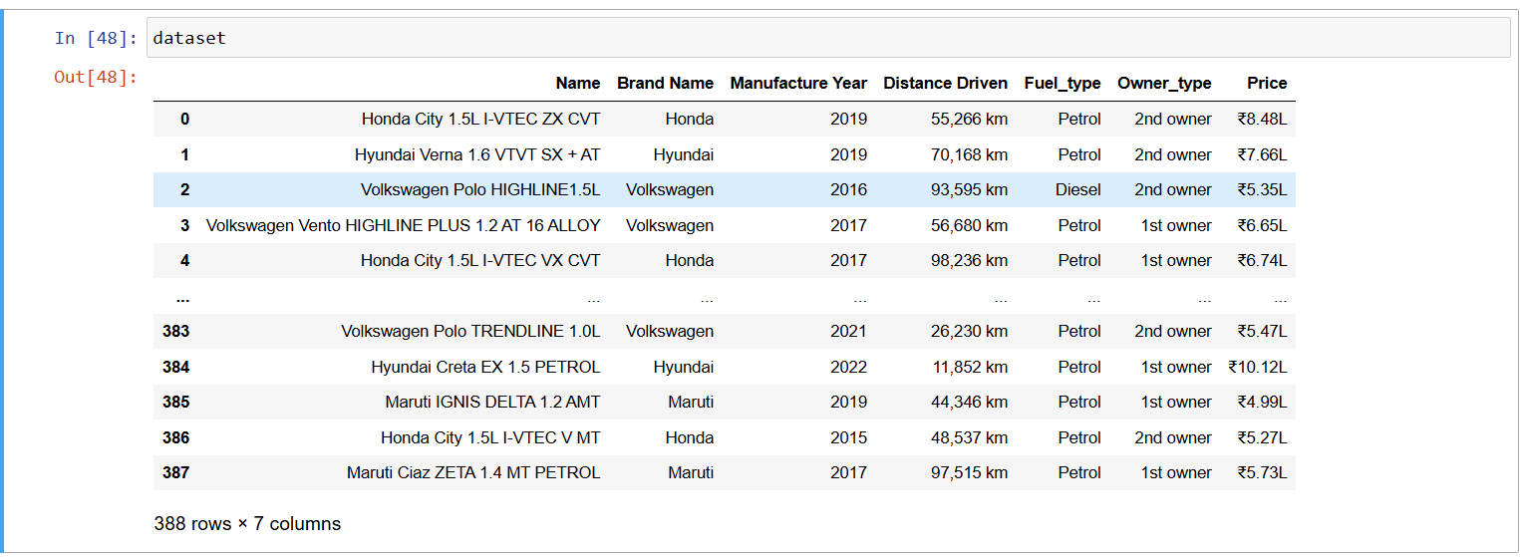
OUTPUT

Slide 14
PREPROCESSING
Import Data :
Load Data : import datasets related to cars data from sources like Excel, csv file into PowerBi
Data Preview : Review the dataset in PowerBi to understand its structure, including columns such as name,brand,year,price,fuel type etc..,
Data Cleaning
Remove Duplicates
Handle Missing Values
Remove rows
Correct Errors

Slide 15
Data Transformation:
Change Data Types: update data types where necessary
Rename Columns : Assign meaningful column names
Data Visualizations:
Leverage PowerBi features to create visualizations such as bar charts, table charts, slicer to analyze trends
Customize dashboards for a clear understanding of insights
Save and Load Data:
Save and publish : After completing data transformations, save the Powerbi workbook and publish it

Slide 16
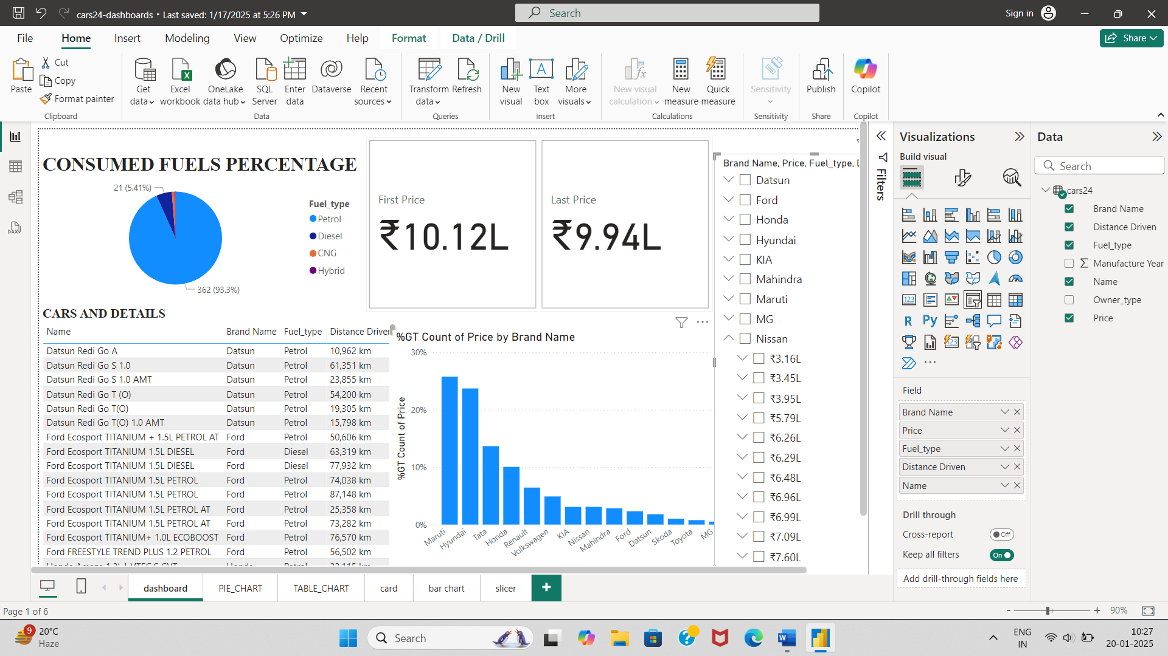
DASHBOARD

Slide 17
THANK YOU

